Slide 1
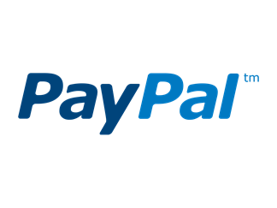
NASCO Crowdfunding Working Group
Results from 50 State Survey on Regulation of Crowdfunding Activities
National Association of State Charities Officials
October 3, 2017

Slide 2
The face of fundraising is changing
Individuals who fundraise on websites make appeals once reserved to charities – “democratization of fundraising”
Websites serve as gateways for donations to any and all charities
Individuals use social media for peer to peer fundraising to benefit charities
Disaster fundraising has moved to the internet

Slide 3
What we did
Crowdfunding working group formed at the 2016 NASCO conference
Group decided early on to learn how states handle issues relating to fundraising via third party websites and social media
Group designed and distributed an online survey for each state to complete
Survey focused on charity regulation, not consumer protection or common law rules

Slide 4
Results
Of 51 states (including DC), 41 responded
While survey included screen shots for illustration, some confusion with subtle distinctions among questions
While survey intended to exclude general consumer protection regulation, some states rely upon those statutes for regulation of fundraising

Slide 5
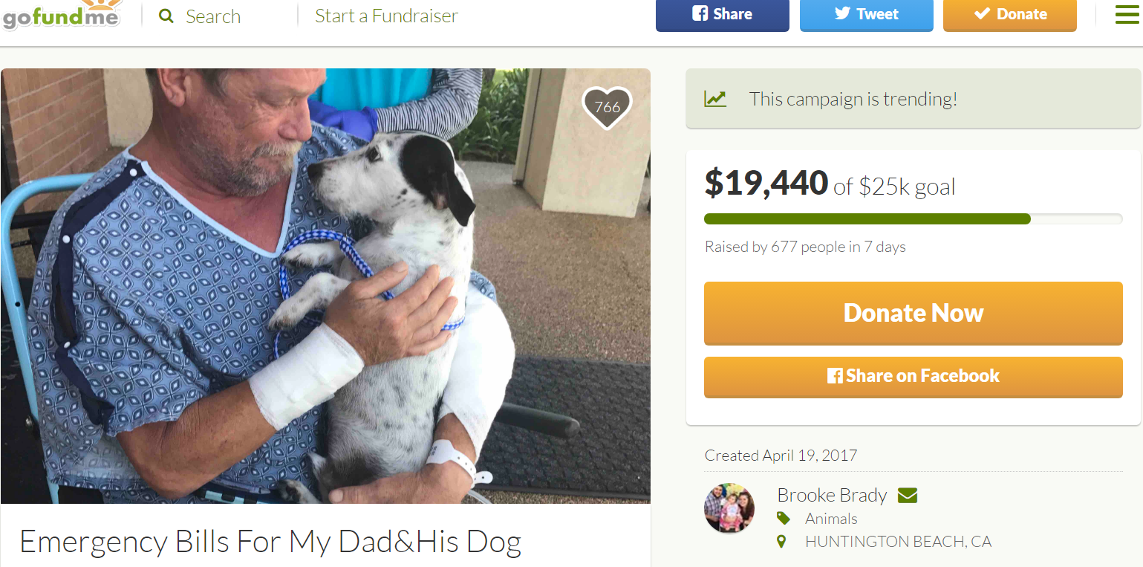
Fundraising for individuals – no benefit to donor

Slide 6
Fundraising for individuals – no benefit
Does your state regulate fundraising by individuals for individuals where there is no opportunity for a benefit?
Yes 14
No 27

Slide 7
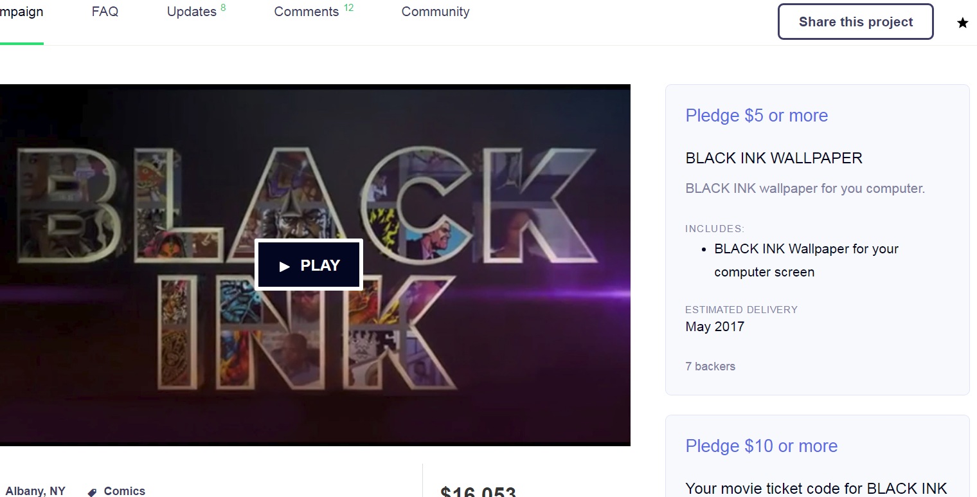
Fundraising for individuals – benefit for donor

Slide 8
Fundraising for individuals - benefit
Does your state regulate fundraising by individuals for individuals where there is an opportunity for a non-equity benefit?
Yes 5
No 36

Slide 9
Fundraising for individuals
Does your state regulate third party websites (GoFundMe, etc.) for their activity hosting fundraising campaigns for individuals where there is no offer of a benefit?
Yes 7
No 34
Does your state regulate third party websites (Kickstarter, etc.) for their activity hosting fundraising campaigns for individuals offering a non-equity benefit?
Yes 5
No 36

Slide 10
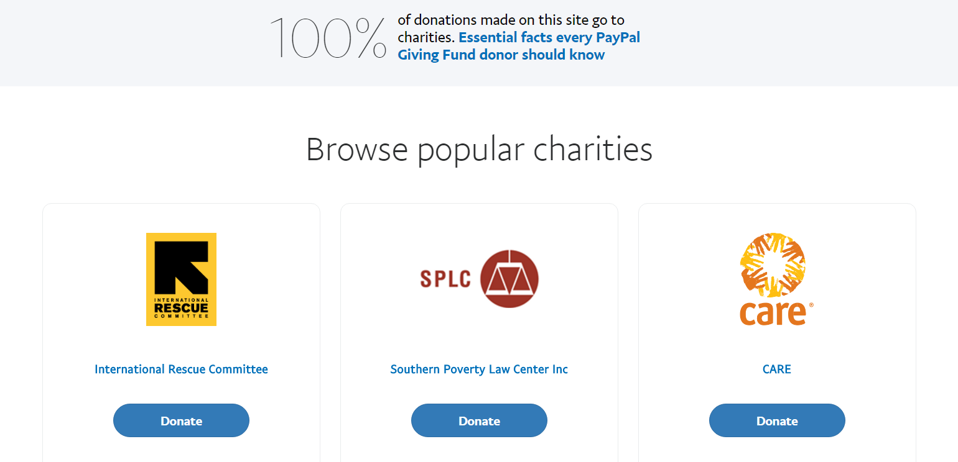
Third party website fundraising for charities

Slide 11
Third party website fundraising for charities

Slide 12
Fundraising for charities
Does your state regulate third party websites for their activity hosting fundraising campaigns submitted by charities?
Yes 19
Only if website charges a fee 8
No 22
If yes, how would you regulate them?
Paid fundraiser 10
Fundraising counsel 4
Commercial co-venture 4

Slide 13
Fundraising for charities
Does your state regulate third party websites for their activity allowing donors to contribute to most any charity (charity list imported from from GuideStar or IRS Master File)?
Yes 19
Only if website charges a fee 5
No 22
If yes, how would you regulate them?
Uncertain: paid fundraiser, fundraising counsel, commercial co-venture
Examples of entities regulated: Amazon Smile, PayPal Giving Fund, GoFundMe Impact Fund, Network for Good

Slide 14
Fundraising for charities
Does your state require that any charity give its permission before a third party website may offer donors the chance to donate to that charity?
Yes 26
Only if website also displays charity’s logo or its written material 1
No 15

Slide 15
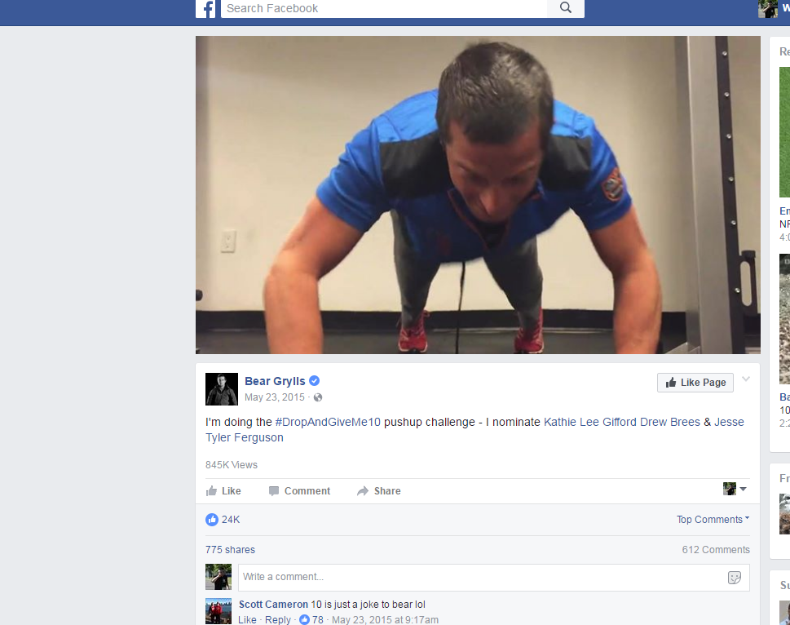
Peer to Peer fundraising campaigns

Slide 16
Peer to peer fundraising campaigns
Does your state regulate individuals who conduct peer to peer campaigns to contribute to a charity using a third party website?
Yes 10
No 31
Does your state require individuals who conduct those peer to peer campaigns to obtain permission from the charity?
Yes 10
Only if individual also displays charity’s logo or its written material 1
No 31

Slide 17
Peer to peer fundraising campaigns
Does your state regulate third party websites that host individual peer to peer campaigns to benefit a charity?
Yes 8
Only if they are compensated or touch the money 1
Only if they are compensated 7
No 33
Does your state require third party websites that host individual peer to peer campaigns to obtain permission from the charity?
Yes 11
No 20

Slide 18
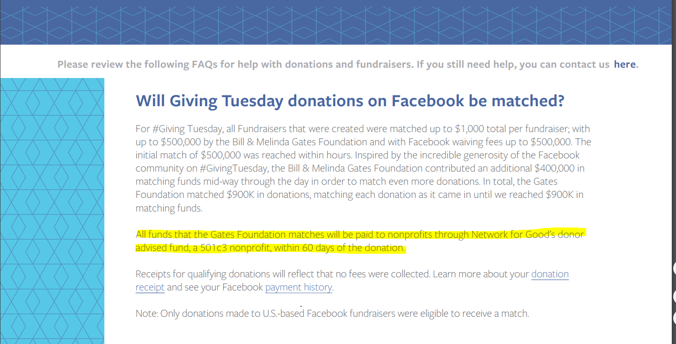
Donor advised fund used as intermediary
Network for Good, PayPal Giving Fund, American Online Giving Foundation, MakeMyDonation, etc.

Slide 19
Donor advised funds
Does your state regulate donor advised fund charities that receive and distribute donations collected for specific charities through a third party website?
Yes 25
As a professional fundraiser, if paid 9
As a charity 14
No 16
Examples: Network for Good, AmazonSmiles, PayPal Giving, American Online Giving, GoFundMe Impact, MakeMyDonation, Fidelity, U.S. Charitable Gift Trust, Schwab

Slide 20
Disaster fundraising

Slide 21
Disaster fundraising
Has your state experienced a disaster or violent event that led to large scale crowdfunding activity?
Yes 22
No 19
Responses by states to disaster fundraising:
Coordination to create a central donation recipient (One Boston, Aurora Victim Relief Fund, OneOrlando)
Outreach to public on wise giving
Outreach to crowdfunding websites
Follow up on complaints
Facilitate closeout of funds and transfers between funds
Issuance of report on disaster fundraising (Sandy Hook)
New statute requiring financial reports for disaster fundraising (Tennessee)

Slide 22
Jurisdictional issues
How does your state address jurisdictional requirements to permit regulation of third party websites through which a donor may make a charitable contribution?
Charleston principles 5
Look whether it targets state residents as donors 9
Look whether it fundraises for a charity operating in the state 1
Not encountered yet 8

Slide 23
Crowdfunding enforcement activity
Has your state engaged in any enforcement activity arising out of crowdfunding?
Yes 17
Administrative investigations 15 (includes Charity Blossom [now defunct], PayPal [ongoing], others)
Fundraising for a charity without its permission 3
Registration as professional fundraiser required 4
Criminal referral for fraud 4
No 24

Slide 24
Crowdfunding benefits and problems
Benefits: charities can raise money quickly, raise awareness of causes, lower fees than with other fundraising methods, good use of social media, individuals can raise money from social network, solicitation is publicly available for all to monitor
Problems: public confusion between charity and individual giving, regulatory scheme unclear, no permission given by charity to appear on website, unclear jurisdiction, charitable fundraising laws not written with crowdfunding in mind, possible increased fraud

Slide 25
Crowdfunding and traditional charities
Any effect in your state on traditional charities resulting from fundraising for individuals using third party websites?
No measurable effect 3
Unknown 25

Slide 26
Evaluation of crowdfunding regulation
Is current professional fundraising law adequate?
Yes 5
No 12
Should self-regulation be encouraged?
Yes 5
No 4
Is there a need for a new uniform law?
Yes 17
No 8
Is there a need for a single registration for 50 states?
Yes 10
No 9

